Slide 1
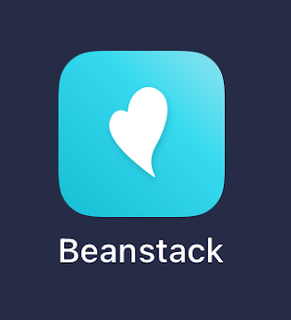
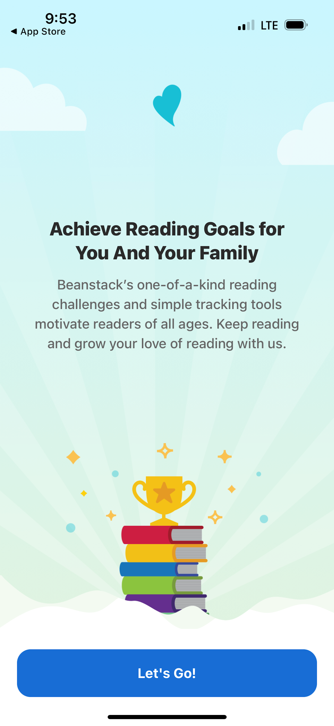
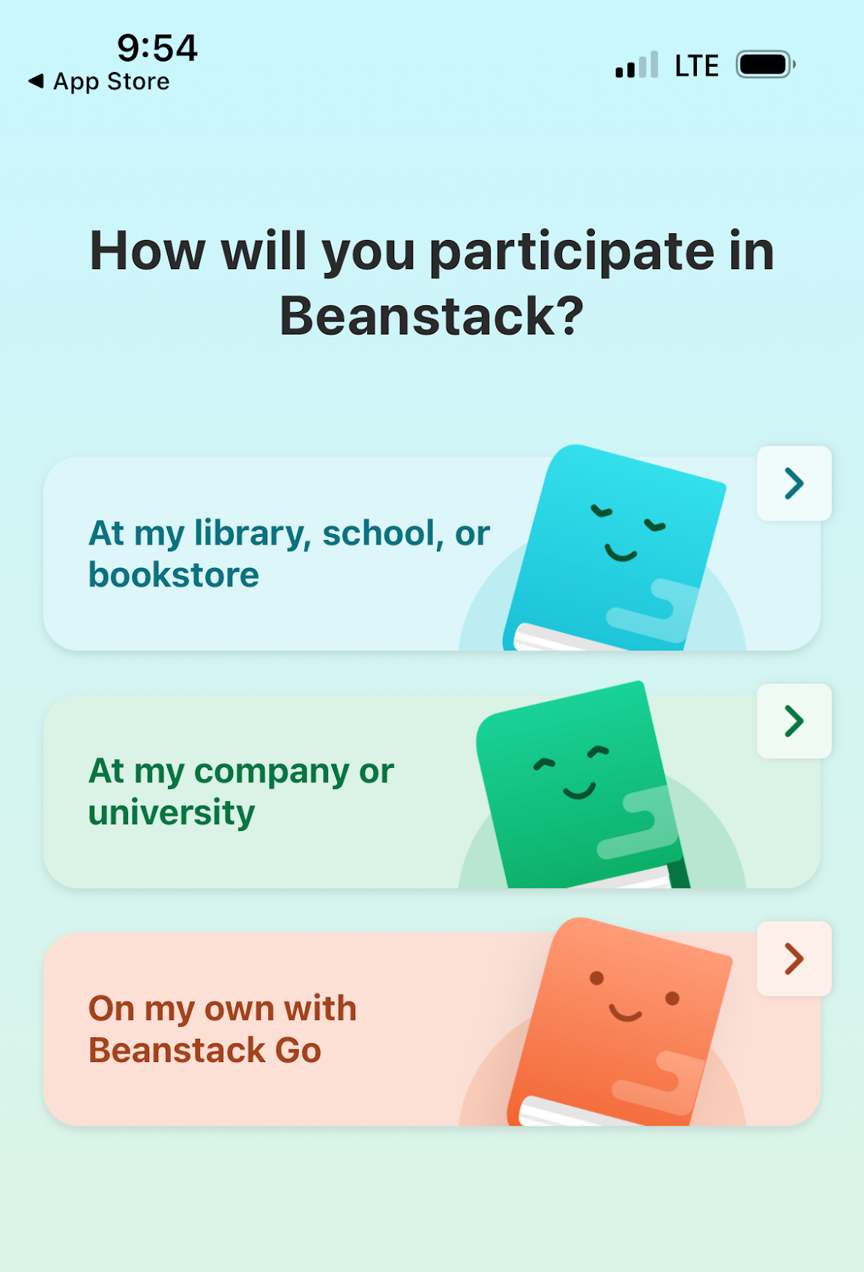
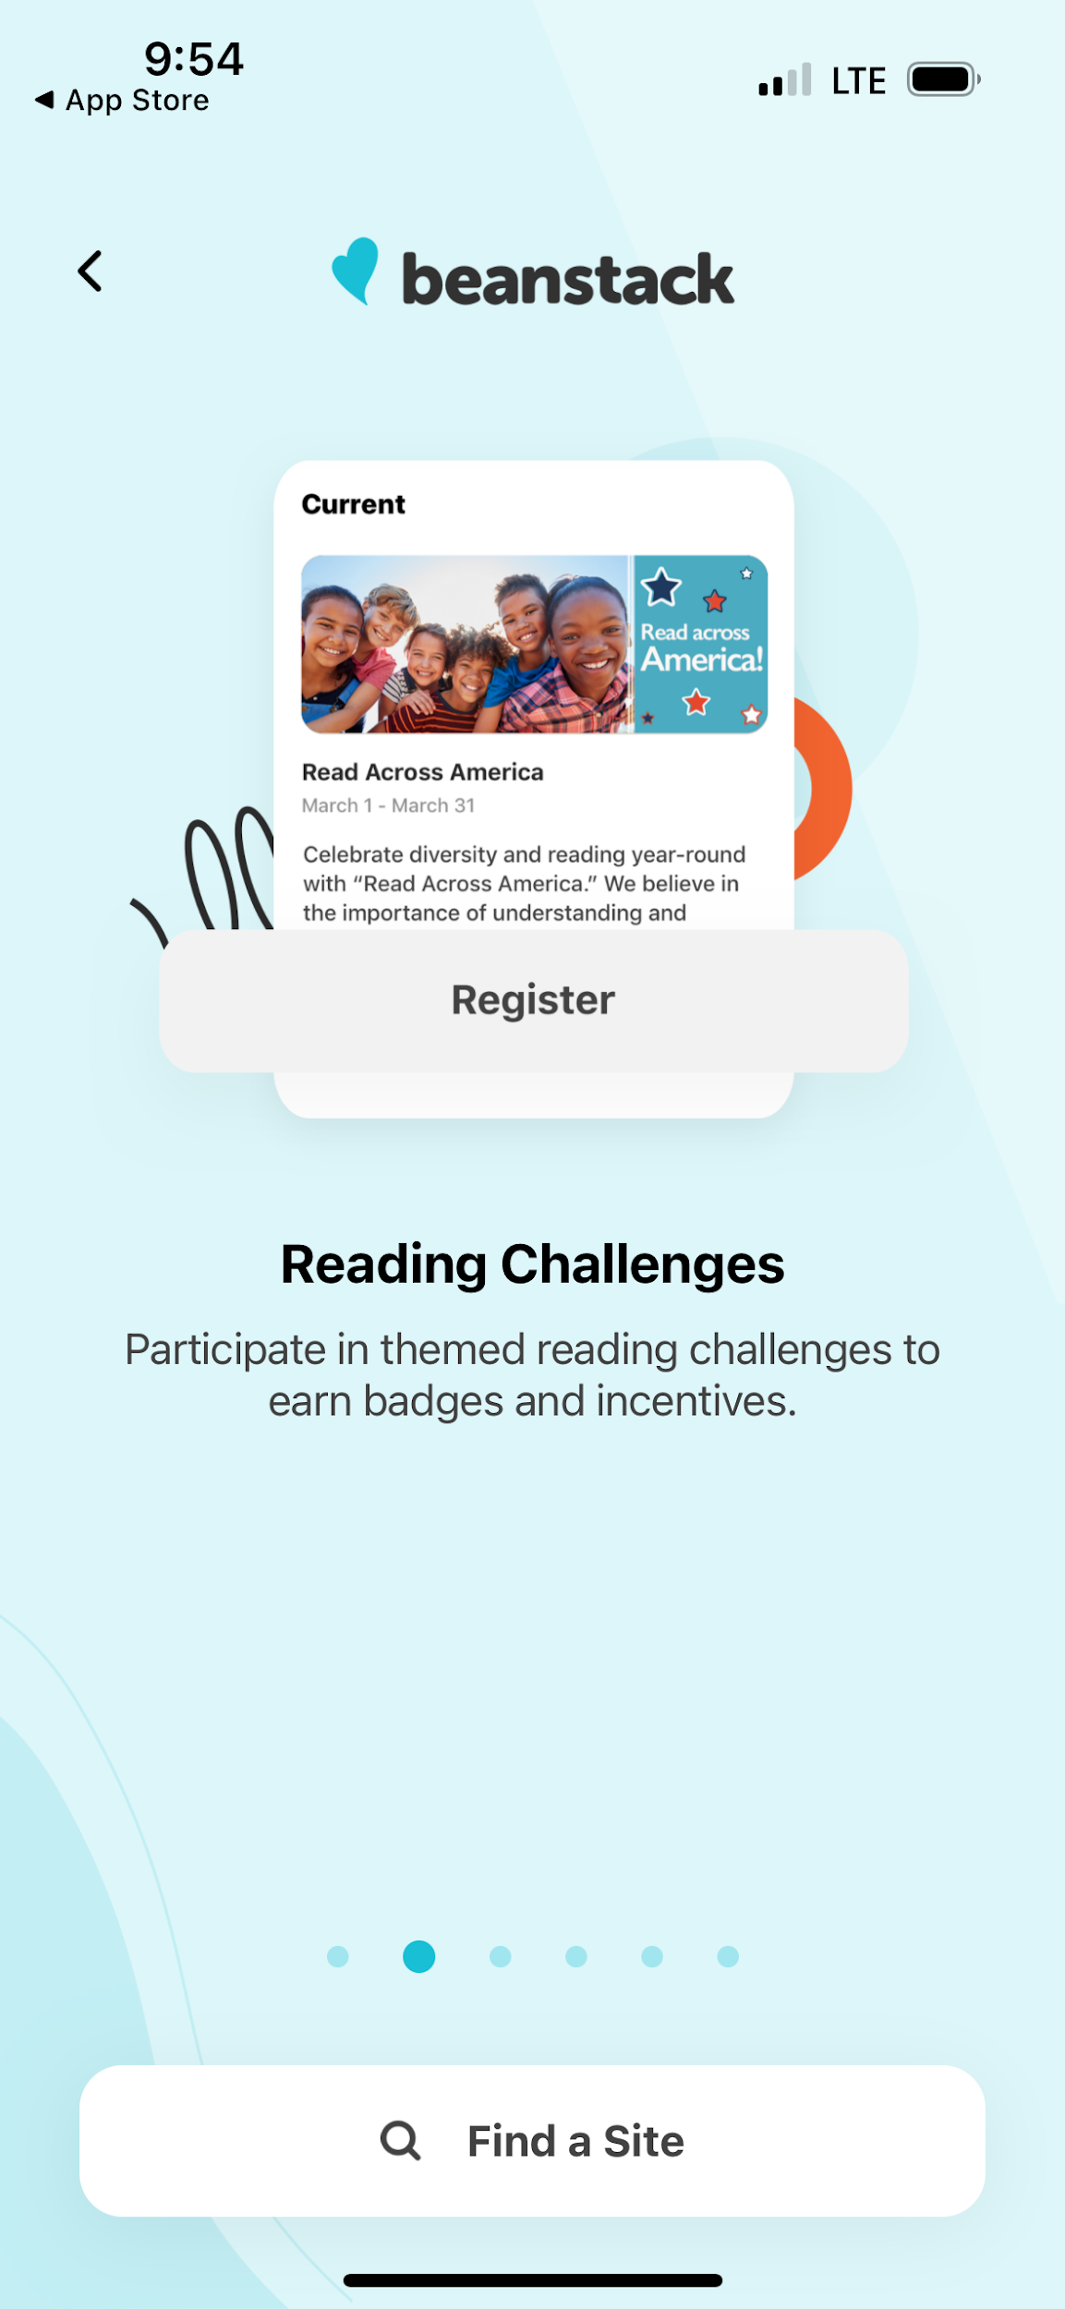
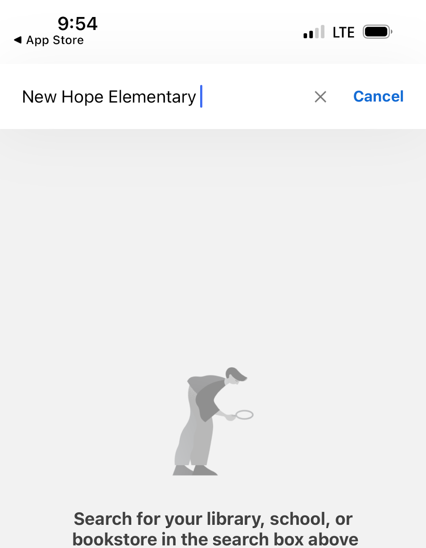
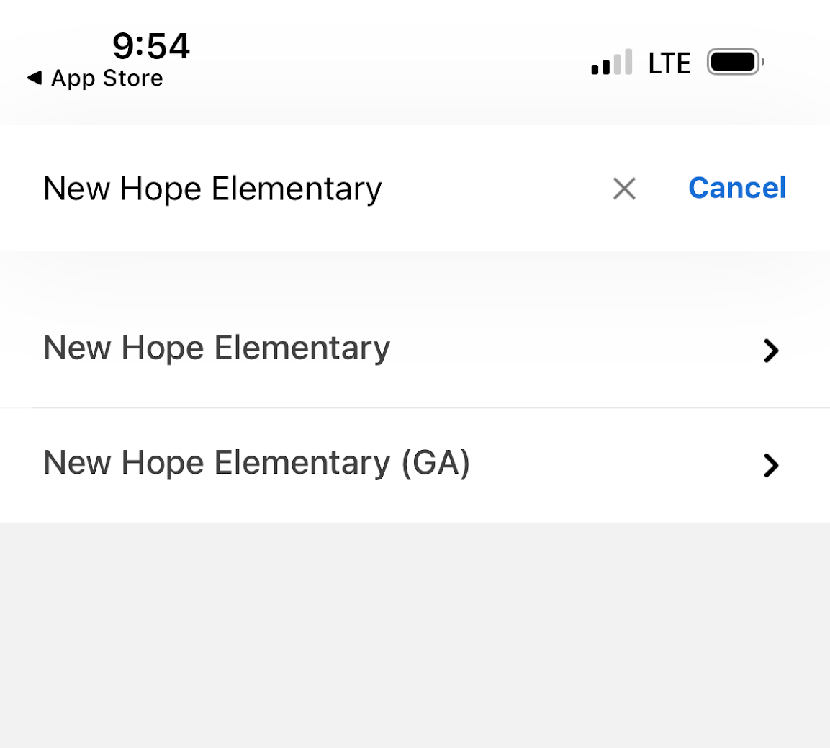
Getting Started with the
Beanstack App
Step 1: Download the Beanstack App from the App Store.
Step 2: Click on “Let’s Go!”
Step 3: Click on “At my library, school, or bookstore”
Step 4: Click on “Find a site”
Step 5: Type Hampton Elementary to search for our school.
Step 6: Select “Hampton Elementary” (the top one)

Slide 2
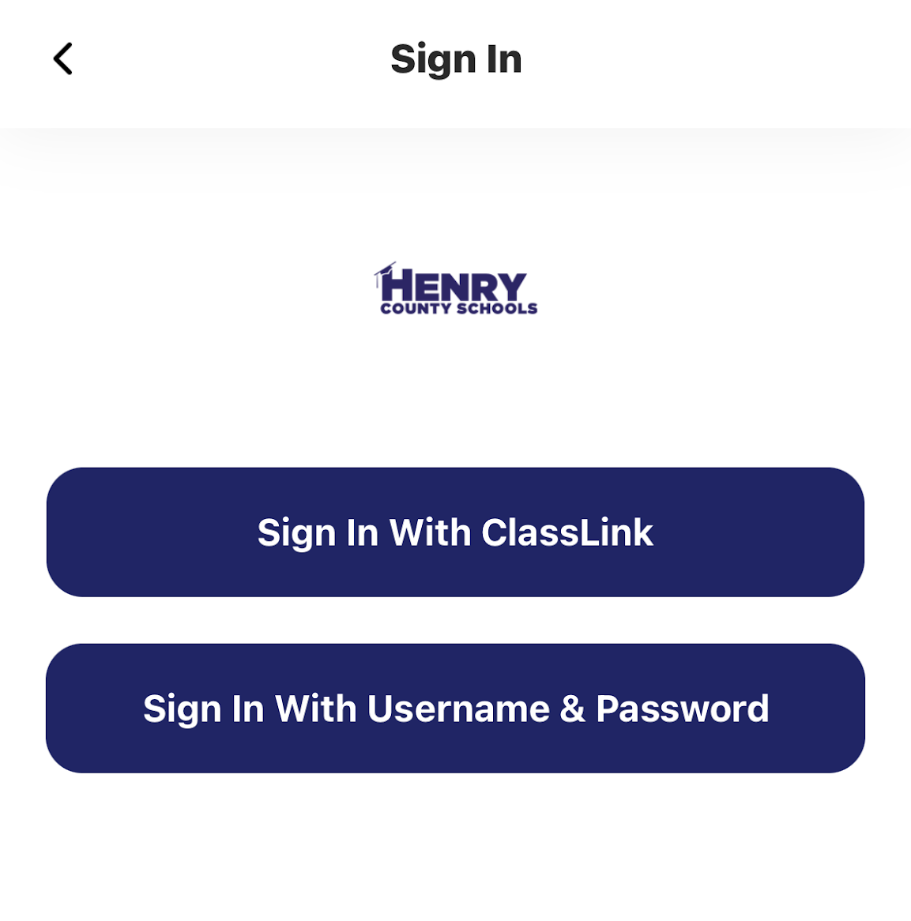
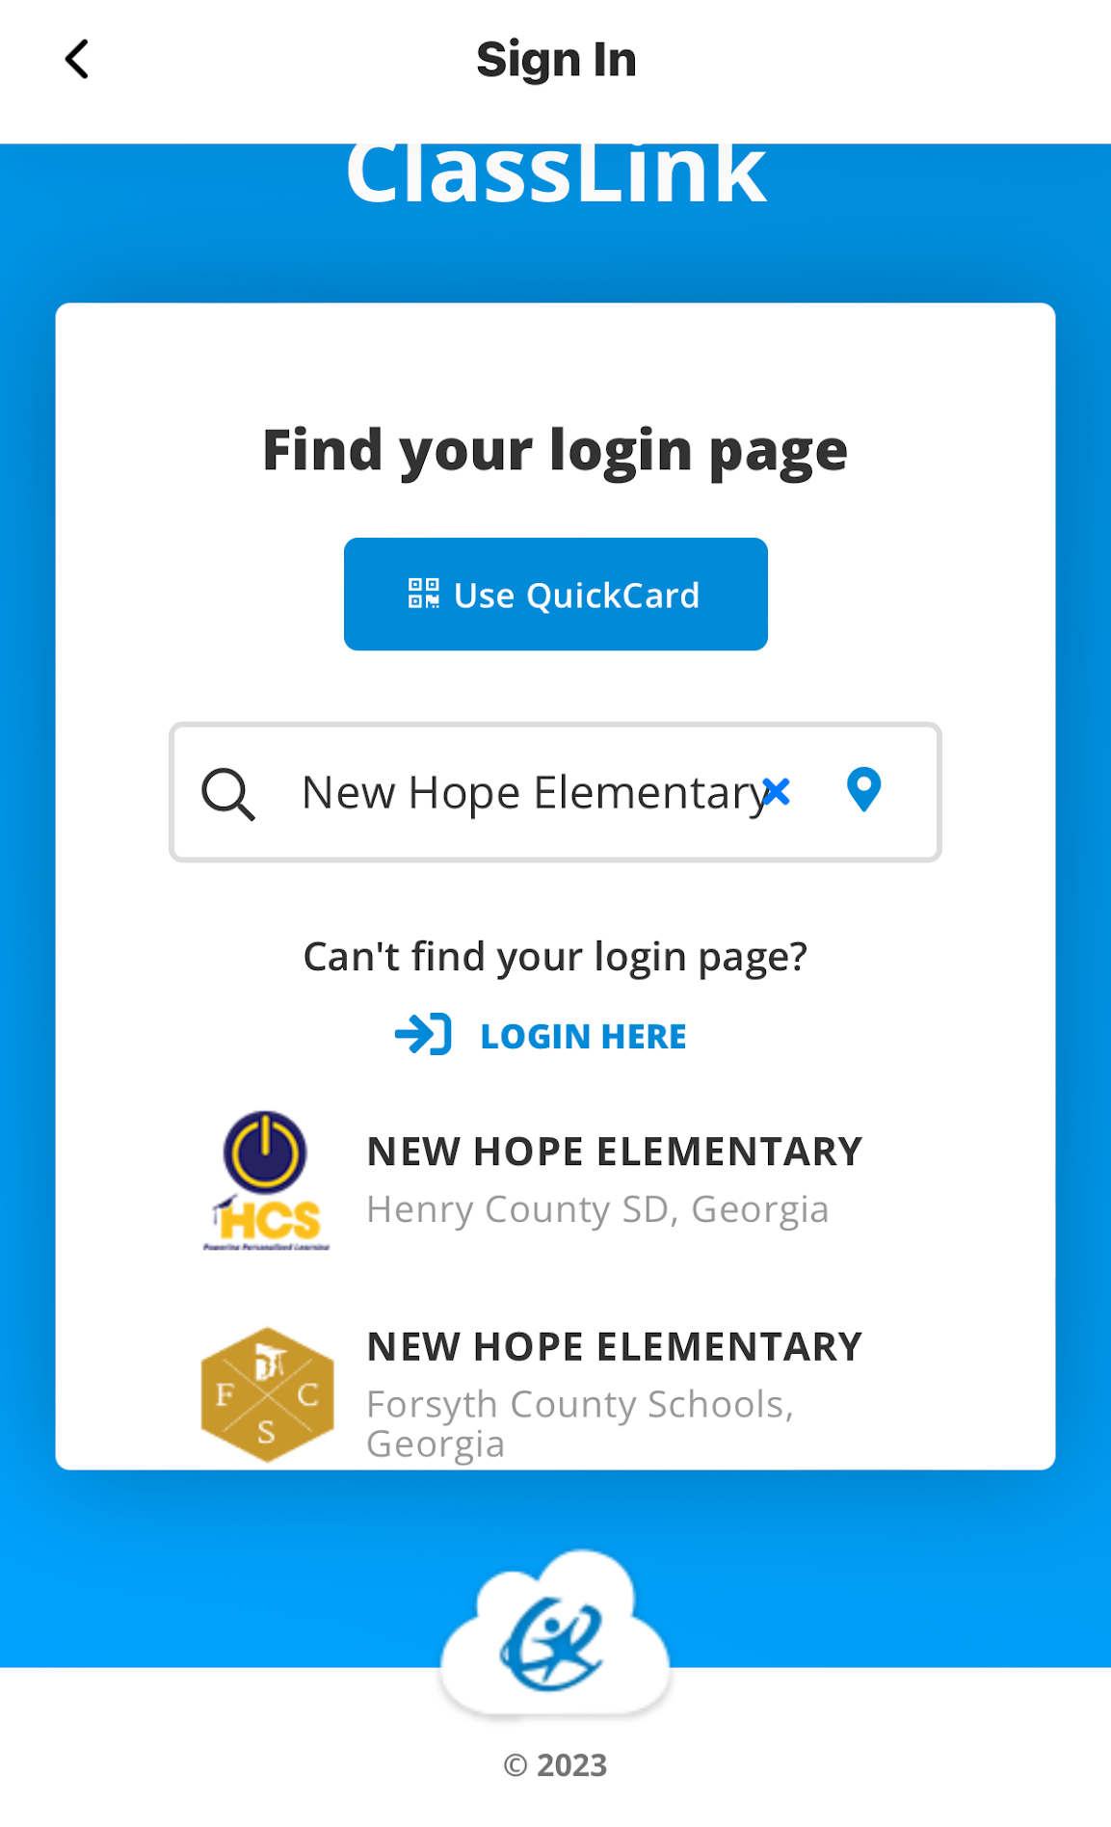
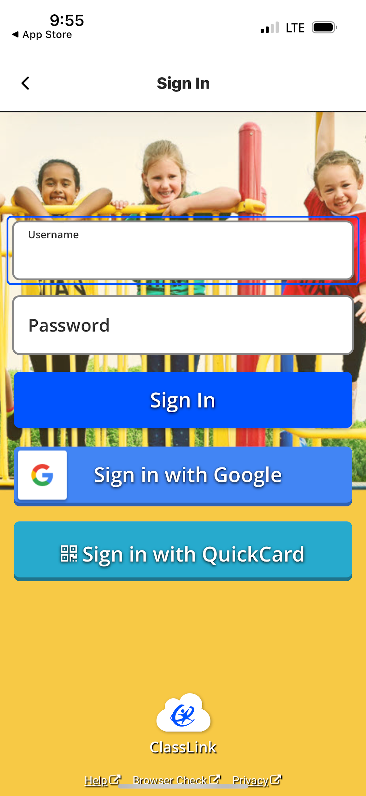
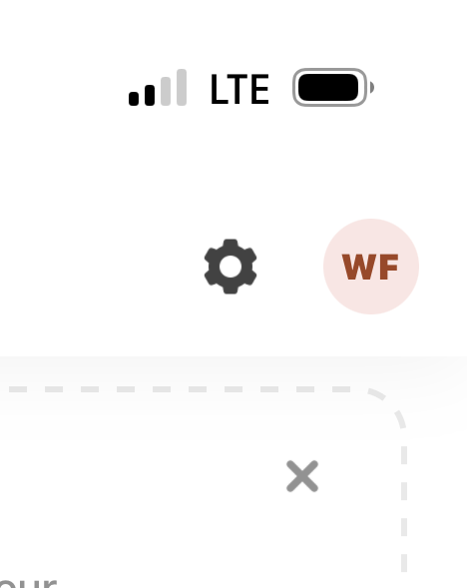
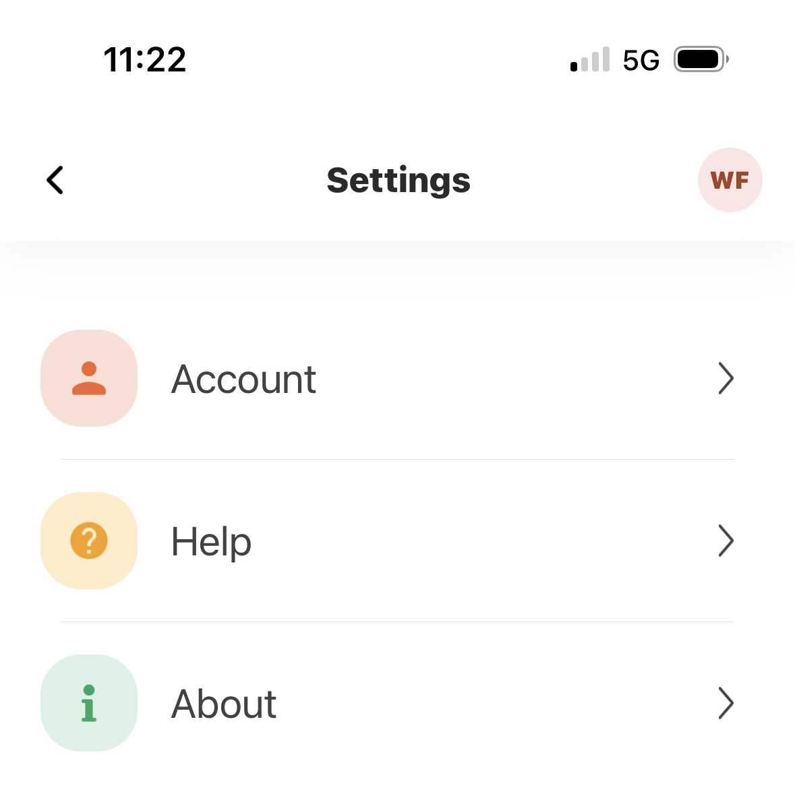
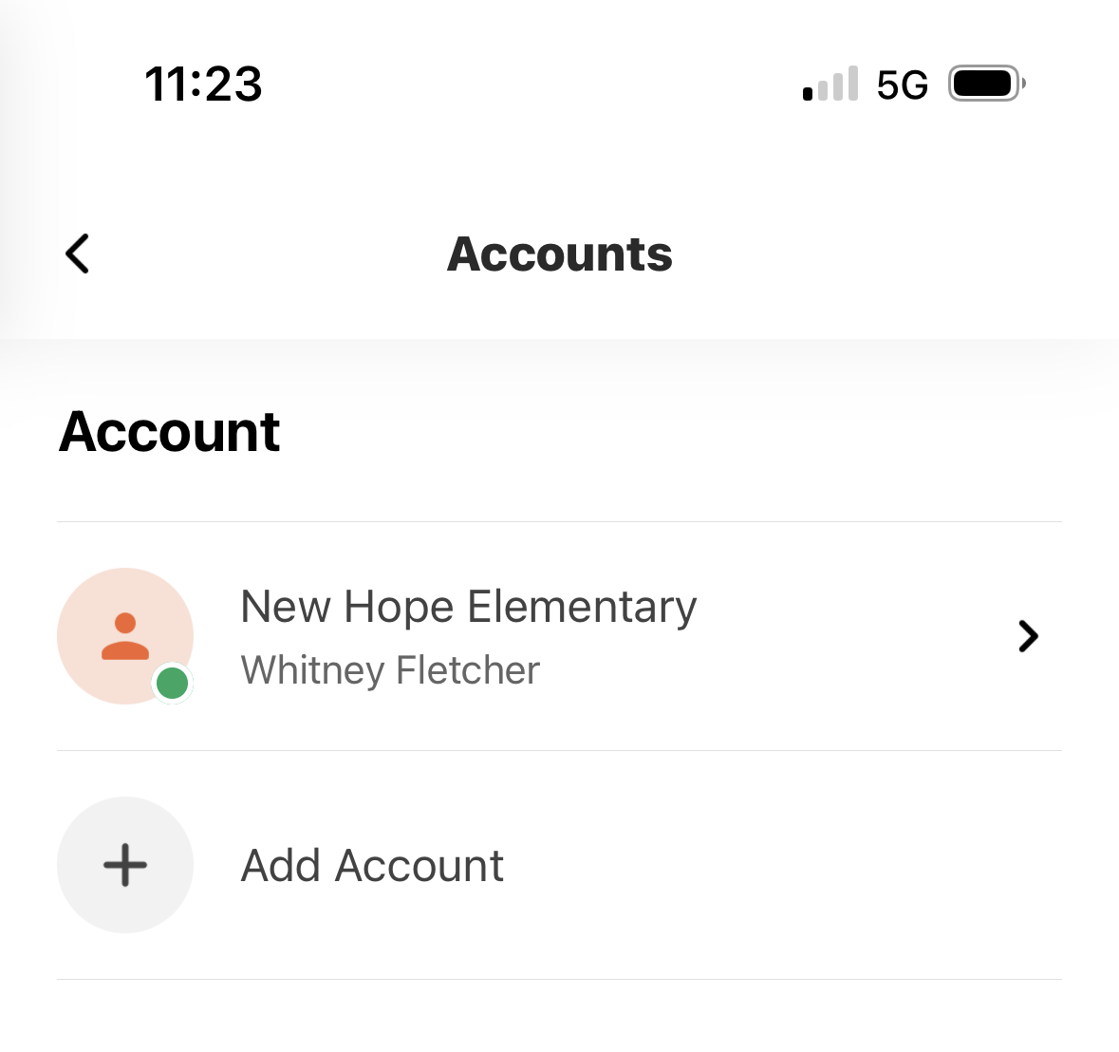
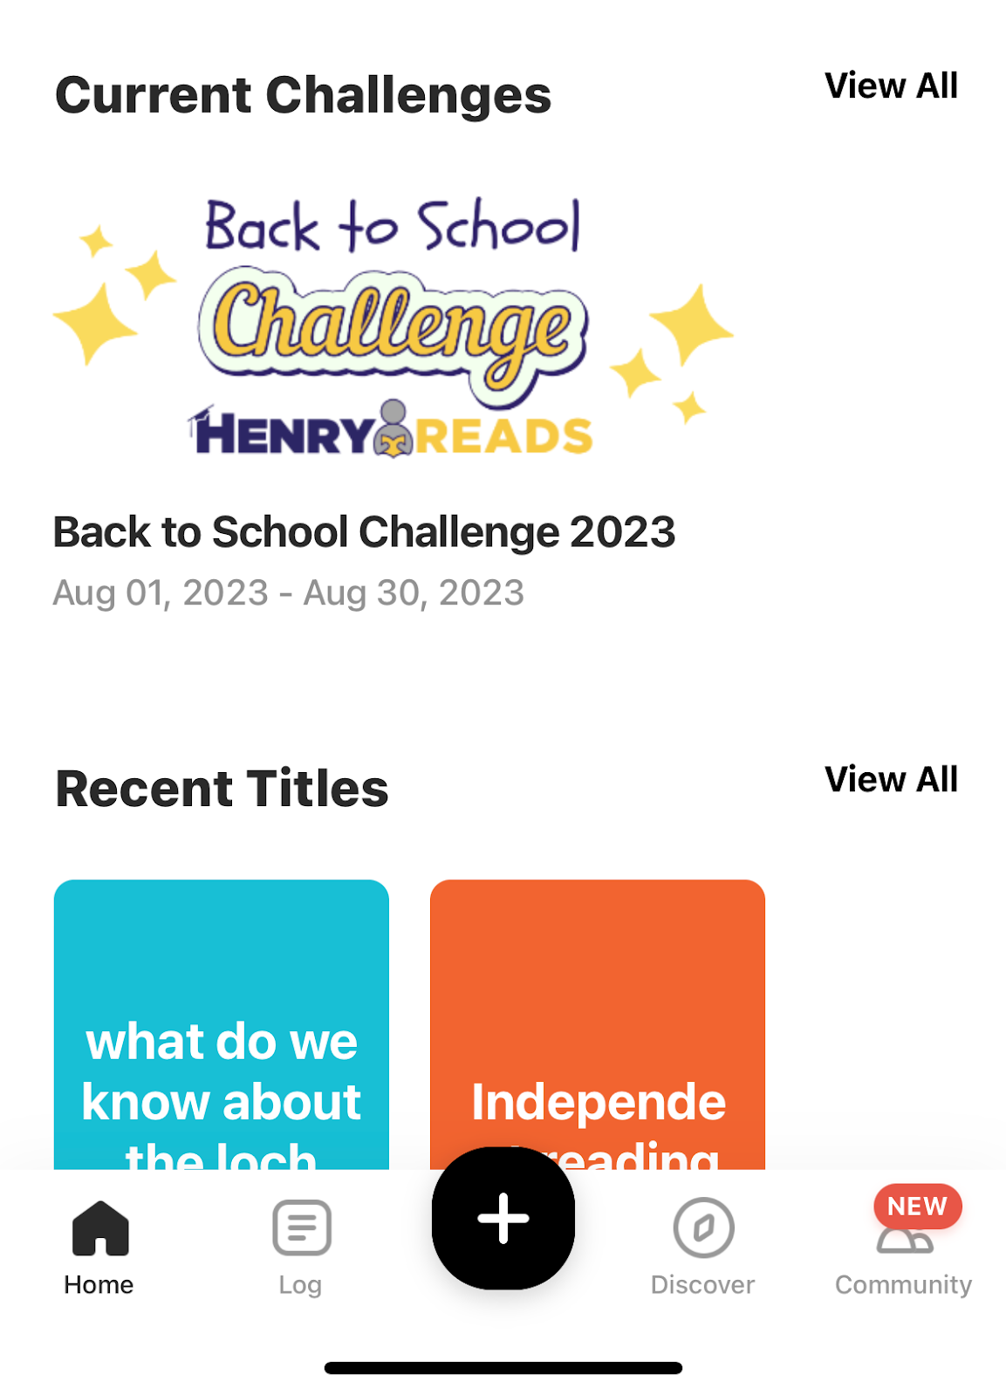
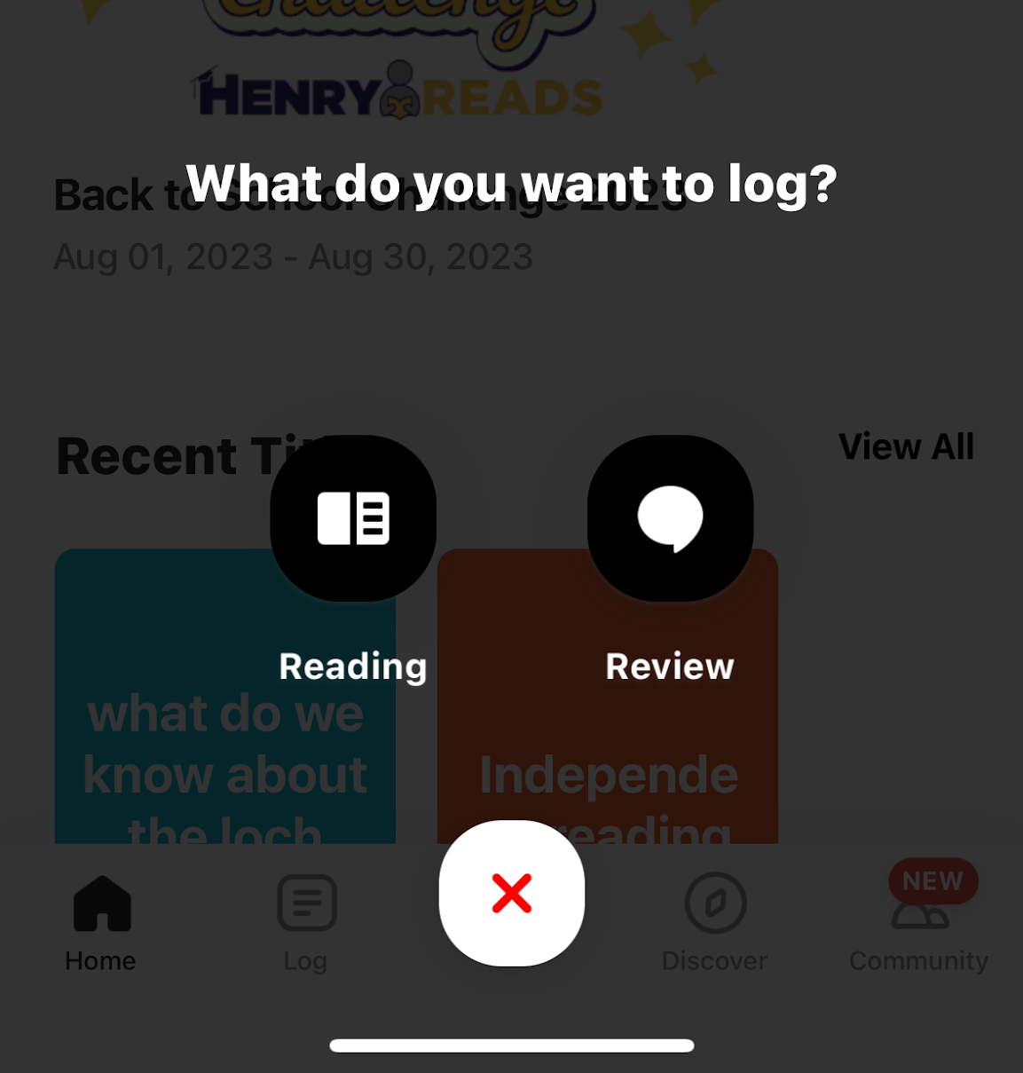
Step 7: Click on “Sign in With ClassLink”
Step 8: Type in “Hampton Elementary” and select “Hampton Elementary Henry County”
Step 9: Log your student in using their credentials.
Username: Student ID
Password: first initial, last initial, six digit birthdate, #
Example: username: 123456
Password: ab010704#
You will need to complete these steps again to enter other users. Once you have logged in, you will not have to complete these steps again.
In order to add another user, click on settings,
Account, and add account
To log reading: Click on the “+” at the bottom of the page. Then, click on “reading”.
Students who log 320 minutes of reading a month (20 min 4 nights a week) will earn the monthly brag tag and could be entered into raffles for other prizes and/or activities.

